Slide 1



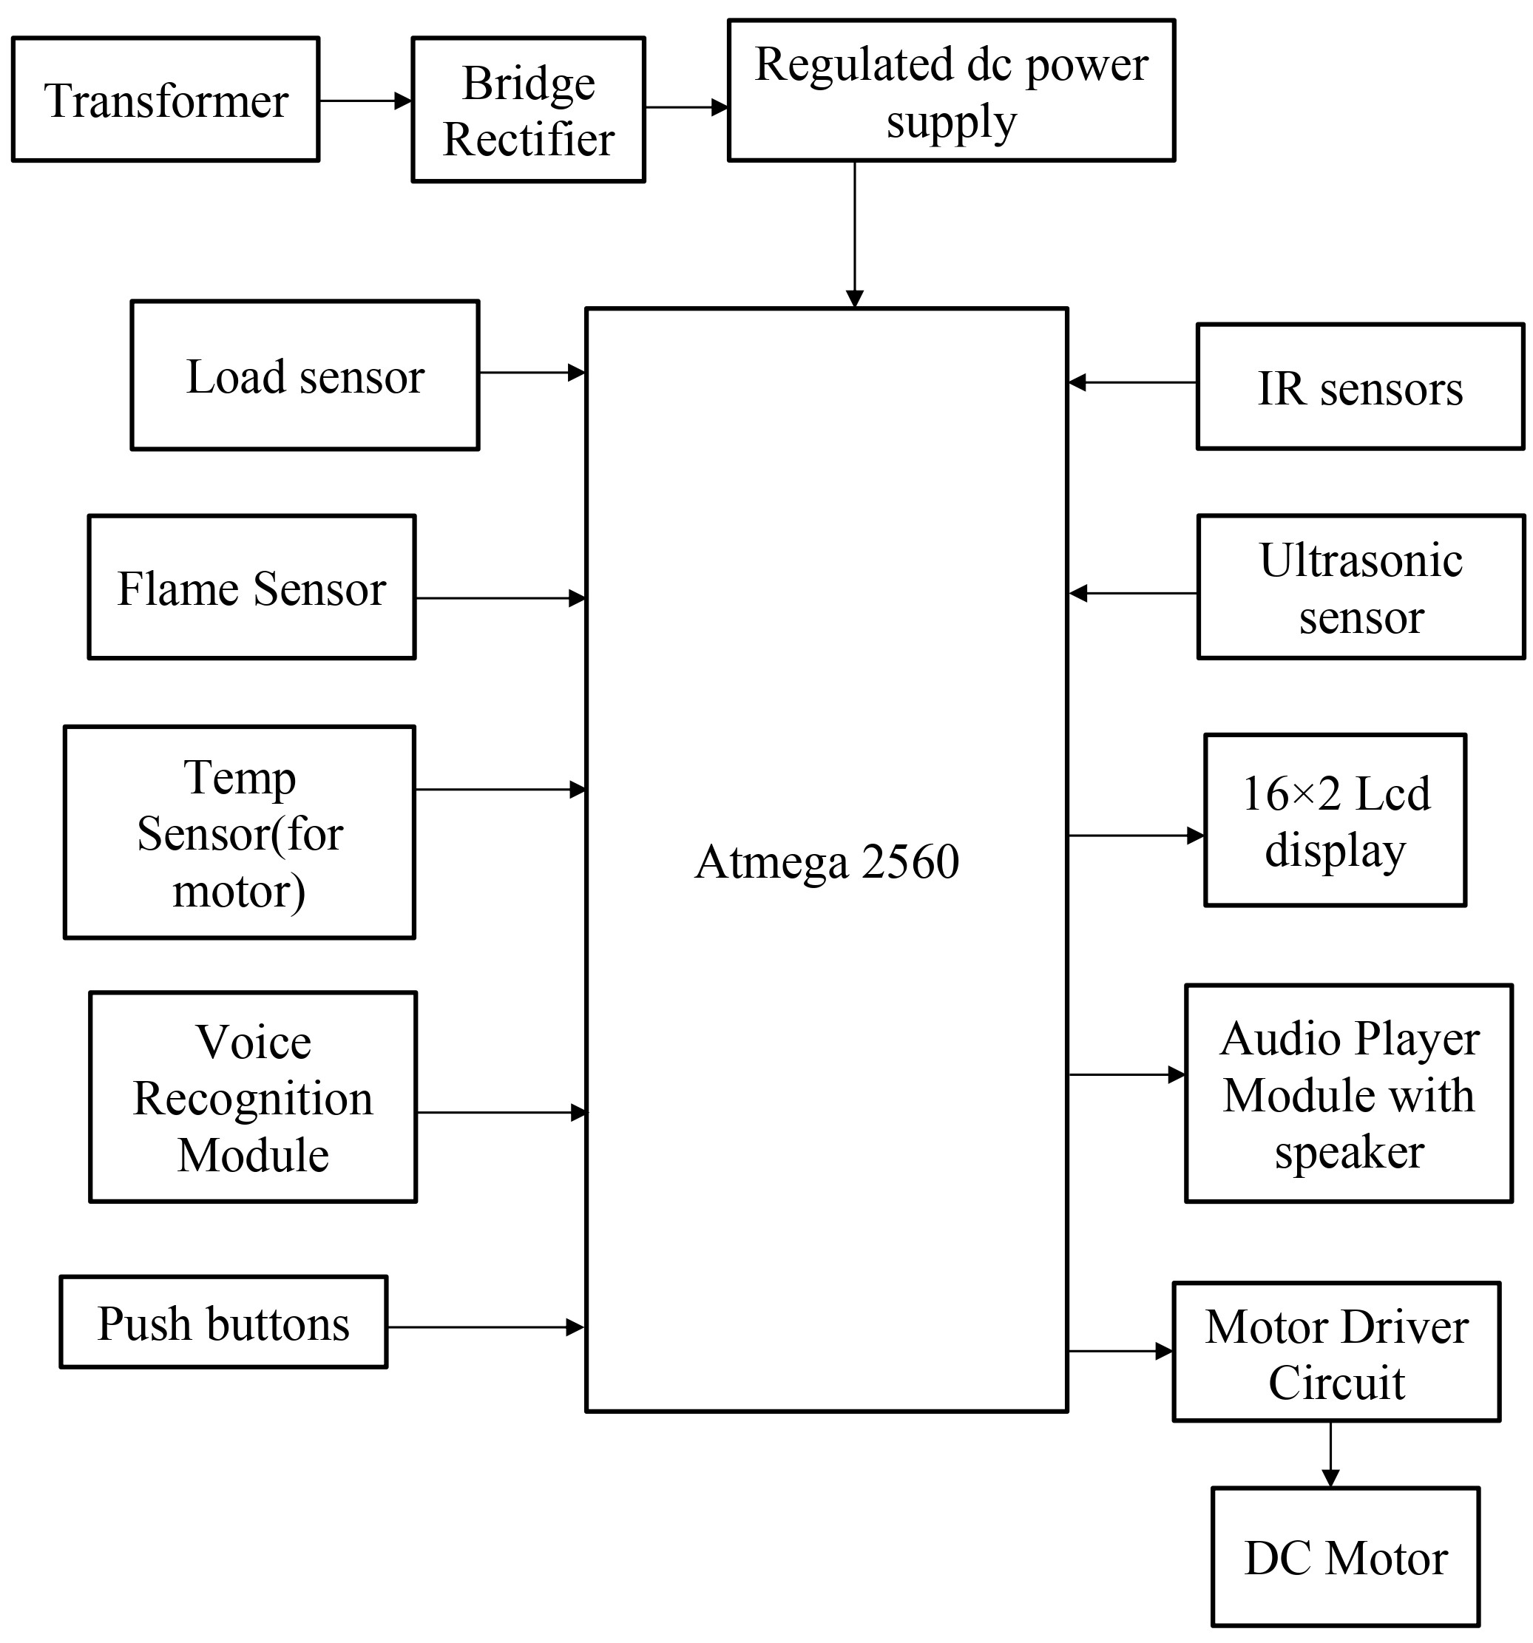
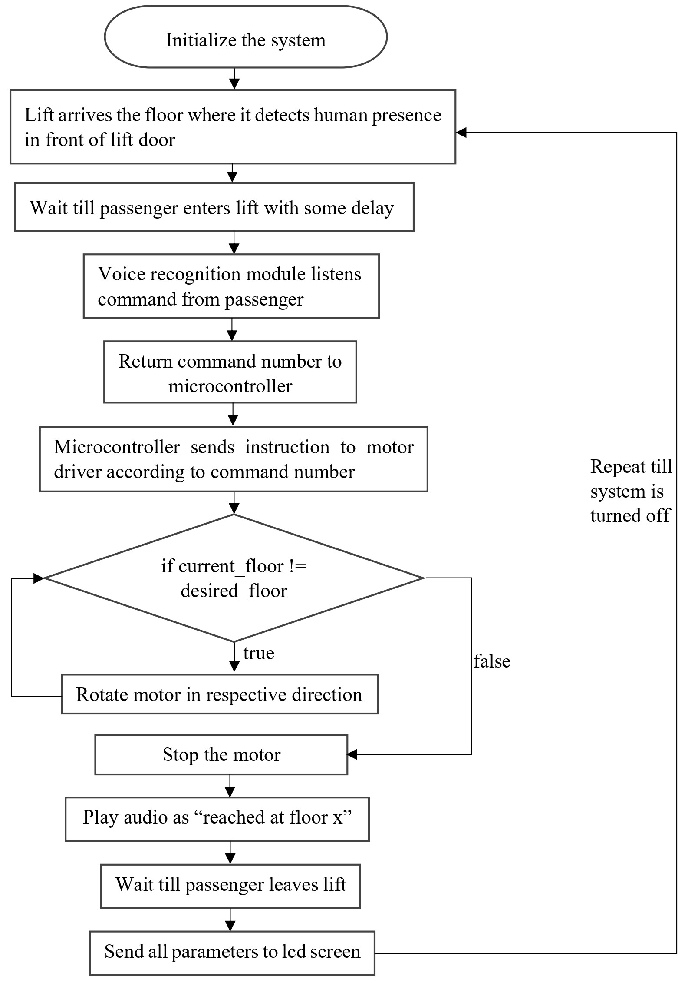
“Voice operated lift control system with safety”
[1] Onkar Waman, [2] Shaileshkumar Zanjare, [3] Aditya Varpe, [4] Gayatri Bhoknal
Guide- Prof. V. R. Aware
Department of Electronics & Telecommunication Engineering
Amrutvahini college of Engineering, Sangamner
Introduction
Physically challenged people face many problems every day. One of these challenges is the use of elevators in many buildings. They should be able to enjoy using the elevator easily.
To overcome this, we must focus on the following issues: Make sure the person is at the elevator door, get elevator there and ask person where to go and accordingly go to respective floor.
Speech is the superior personality of the human beings gifted by the nature. Speech recognition is the process of the computer recognizing human speech to generate a string of words or commands. Sometimes it is known as automatic speech recognition.
Speech recognition is becoming more perplexing and difficult task. The speech recognition research is focuses mainly on large vocabulary, continuous speech capabilities and speaker independence[1].
A voice-operated elevator system is proposed where the user’s input commands to control the movement of the elevator system are kept convenient for the users. The commands include voice input for the floor operations, directions, elevator car’s door operation, and a special command to call for emergency[2].
Need of Project
The visually challenged people cannot use the elevator easily. Sometimes the keypad has Braille technique, but they will have hard time for locating it. Even if they found the keypad, how can they know the number if they do not know Braille?
They always need help in elevators from someone to press the button for them and to tell them when the elevator cabin arrives. In case of emergency how they will act if there is no one with them to help . So voice-controlled elevator can be a very good option for this people.
One more drawback of the current lift is that it cannot tell on which floor the lift is stuck, nor the parameters like temperature of motor, fire detection inside the lift. But by using this voice operated lift we can solve all these problems.
Research Motivation
Elevators are an integral part of modern urban infrastructure, providing vertical transportation for millions of people daily. While elevator technology has advanced significantly over the years, there are still areas that require improvement, particularly in terms of user convenience and safety.
As most of the physically challenged people find it difficult to operate the elevator. Also modern elevators lacks features such as voice recognition.
So we’ve found a solution on this, integrating voice recognition capabilities with the lift(elevator) for conveniently operate elevator with just some voice commands and also get feedback in audio format from the lift control system.
Also send all this info in real-time to the lcd screen.
Aim
Design and development of a voice-controlled lift/elevator control system with enhanced security features for human-machine communication.
Objectives
To operate lift through voice commands with easy use for people with visual and physical challenges.
To measure parameters like floor number, weight of the lift, fire detection, temperature of motor.
To give real time information of lift parameters on the lcd screen.
Block Diagram
Flowchart
Results and Discussion
Safety features prevented near-miss incident: The built-in overload sensor successfully halted a lift when exceeding maximum capacity, potentially avoiding a dangerous situation.
Parameters: All the system related parameters were correctly received on the inbuilt LCD display of the system.
Voice recognition: Almost all commands were recognized by voice recognition module in medium noisy surrounding.
Advantages
Accessibility: Voice control can be easier to use for people with physical disabilities or limitations than traditional button controls.
Hygiene: Using voice commands can help to reduce the spread of germs, as people don't need to touch buttons.
Convenience: Voice control can be a more convenient way to call a lift, especially when carrying items or with full hands.
Safety: The system includes safety features such as load sensors, IR sensors, flame sensors, temperature sensors, and ultrasonic sensors, which can help to prevent accidents.
Modernization: A voice-operated lift control system can give a building a more modern and high-tech feel.
Limitations
Accuracy: Voice recognition systems can sometimes be inaccurate, especially if there is background noise or if the speaker has a strong accent.
Privacy: Some people may be concerned about the privacy implications of using a voice-operated system.
Cost: Installing and maintaining a voice-operated lift control system can be more expensive than a traditional system.
Application
Hospitals: In hospitals, voice control can be helpful for patients and staff who may have difficulty using traditional buttons.
Hotels: Voice-operated lifts can be a luxurious and modern addition to hotels.
Residential buildings: Voice control can be a convenient option for people living in residential buildings, especially for those with disabilities.
Public buildings: Voice-operated lifts can be helpful in public buildings such as libraries and museums, where people may be carrying items or have difficulty using traditional buttons.
Conclusions
Voice-controlled elevators are a long-term solution that can be used by anyone, including people with disabilities. They have the potential to make life easier for everyone and reduce the spread of germs.
In addition to the benefits mentioned above, voice-controlled elevators could also be used to improve security and convenience. For example, authentication could be used to restrict access to certain floors, and sensors could be used to reduce the need for users to give specific commands.
Overall, voice-controlled elevators are a promising technology with the potential to improve our lives in many ways.
References
Kaladharan N, Assistant Professor ,Dept. of Electrical Engineering. Annamalai University, IJIRCCE, “A study of speech recognition” volume.3,issue 9,page 8030- 8034,September 2015.
Komal Mahajan, Riddhi Nahar, Dhanali Khairnar, Shrutika Kinge, Sujata Suryawanshi, “Elevator Control Using Speech Recognition for People with Physical Disabilities” IJARIIE Vol-7 Issue-3 2021

